Slide 1

Analysis of Cyclistic - Casual to Annual Members
Understanding Membership Types, Ride Lengths, and Usage Patterns

Slide 2
Problem Statement: Understanding Rider Behavior for Cyclistic Bike-Share
Background: Cyclistic, a bike-sharing company, caters to both casual riders and annual members. To optimize marketing efforts and enhance user experiences, we need to analyse rider behaviour and identify patterns.
Problem: We aim to understand how casual riders and annual members use Cyclistic bikes differently. We want to answer the following questions:
What are the usage patterns of casual riders vs. annual members?
When do riders use bikes the most (e.g., weekdays, weekends)?
How does trip duration vary between the two groups?
Are there seasonal trends in bike usage?
For this analysis we focus on 1st problem statement What are the usage patterns of casual riders vs. annual members?
Importance: Solving this problem will help Cyclistic tailor marketing strategies, improve bike availability, and enhance customer satisfaction.

Slide 3
Analysis of Cycle Hire Patterns
Understanding Membership Types, Ride Lengths, and Usage Patterns
Our analysis will focus on the following questions:
Usage Patterns: Casual riders use the service occasionally, often for leisure, while annual members use it regularly for commuting.
Trip Duration: Members usually take shorter rides, likely for commuting, while casual riders take longer rides for leisure or exploration.
Seasonal Trends: Both types of riders ride more in summer due to favorable weather and less in spring and winter due to less favorable conditions.

Slide 4
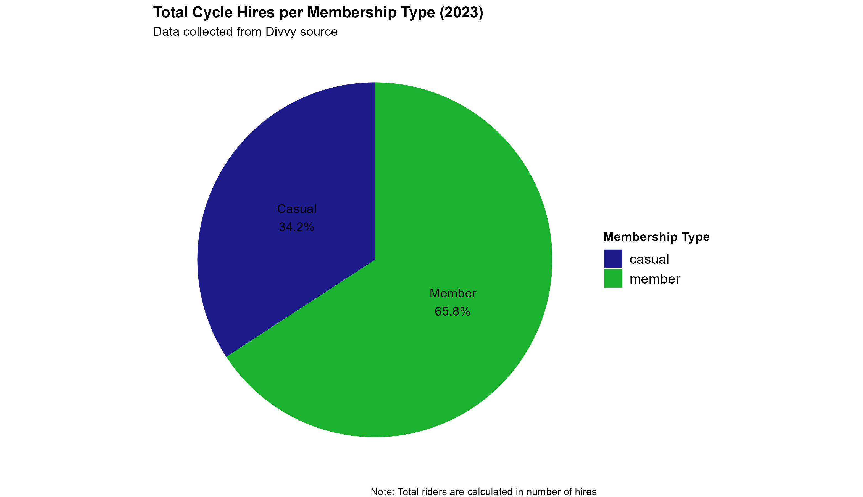
Membership Types
Pie chart showing the proportion of cycle hires made by members and casual users.
Key Points:
Members account for 65.8% of hires.
Casual users make up 34.2% of hires.
Potential to convert casual users to members.

Slide 5
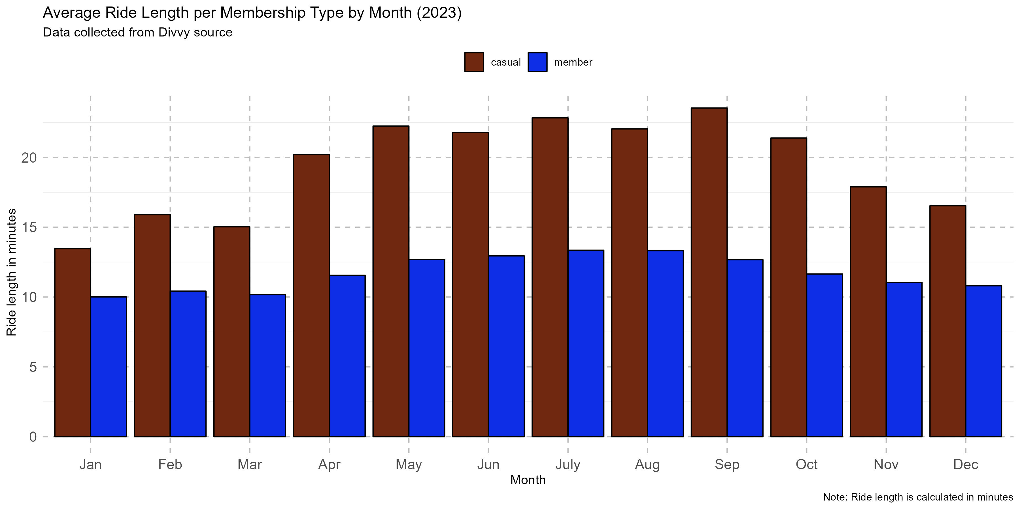
Ride Lengths
Bar chart comparing ride lengths of casual users and members across different months.
Key Points:
Casual users have longer ride lengths, especially in July and August.
Suggests leisure or tourism usage among casual users.

Slide 6
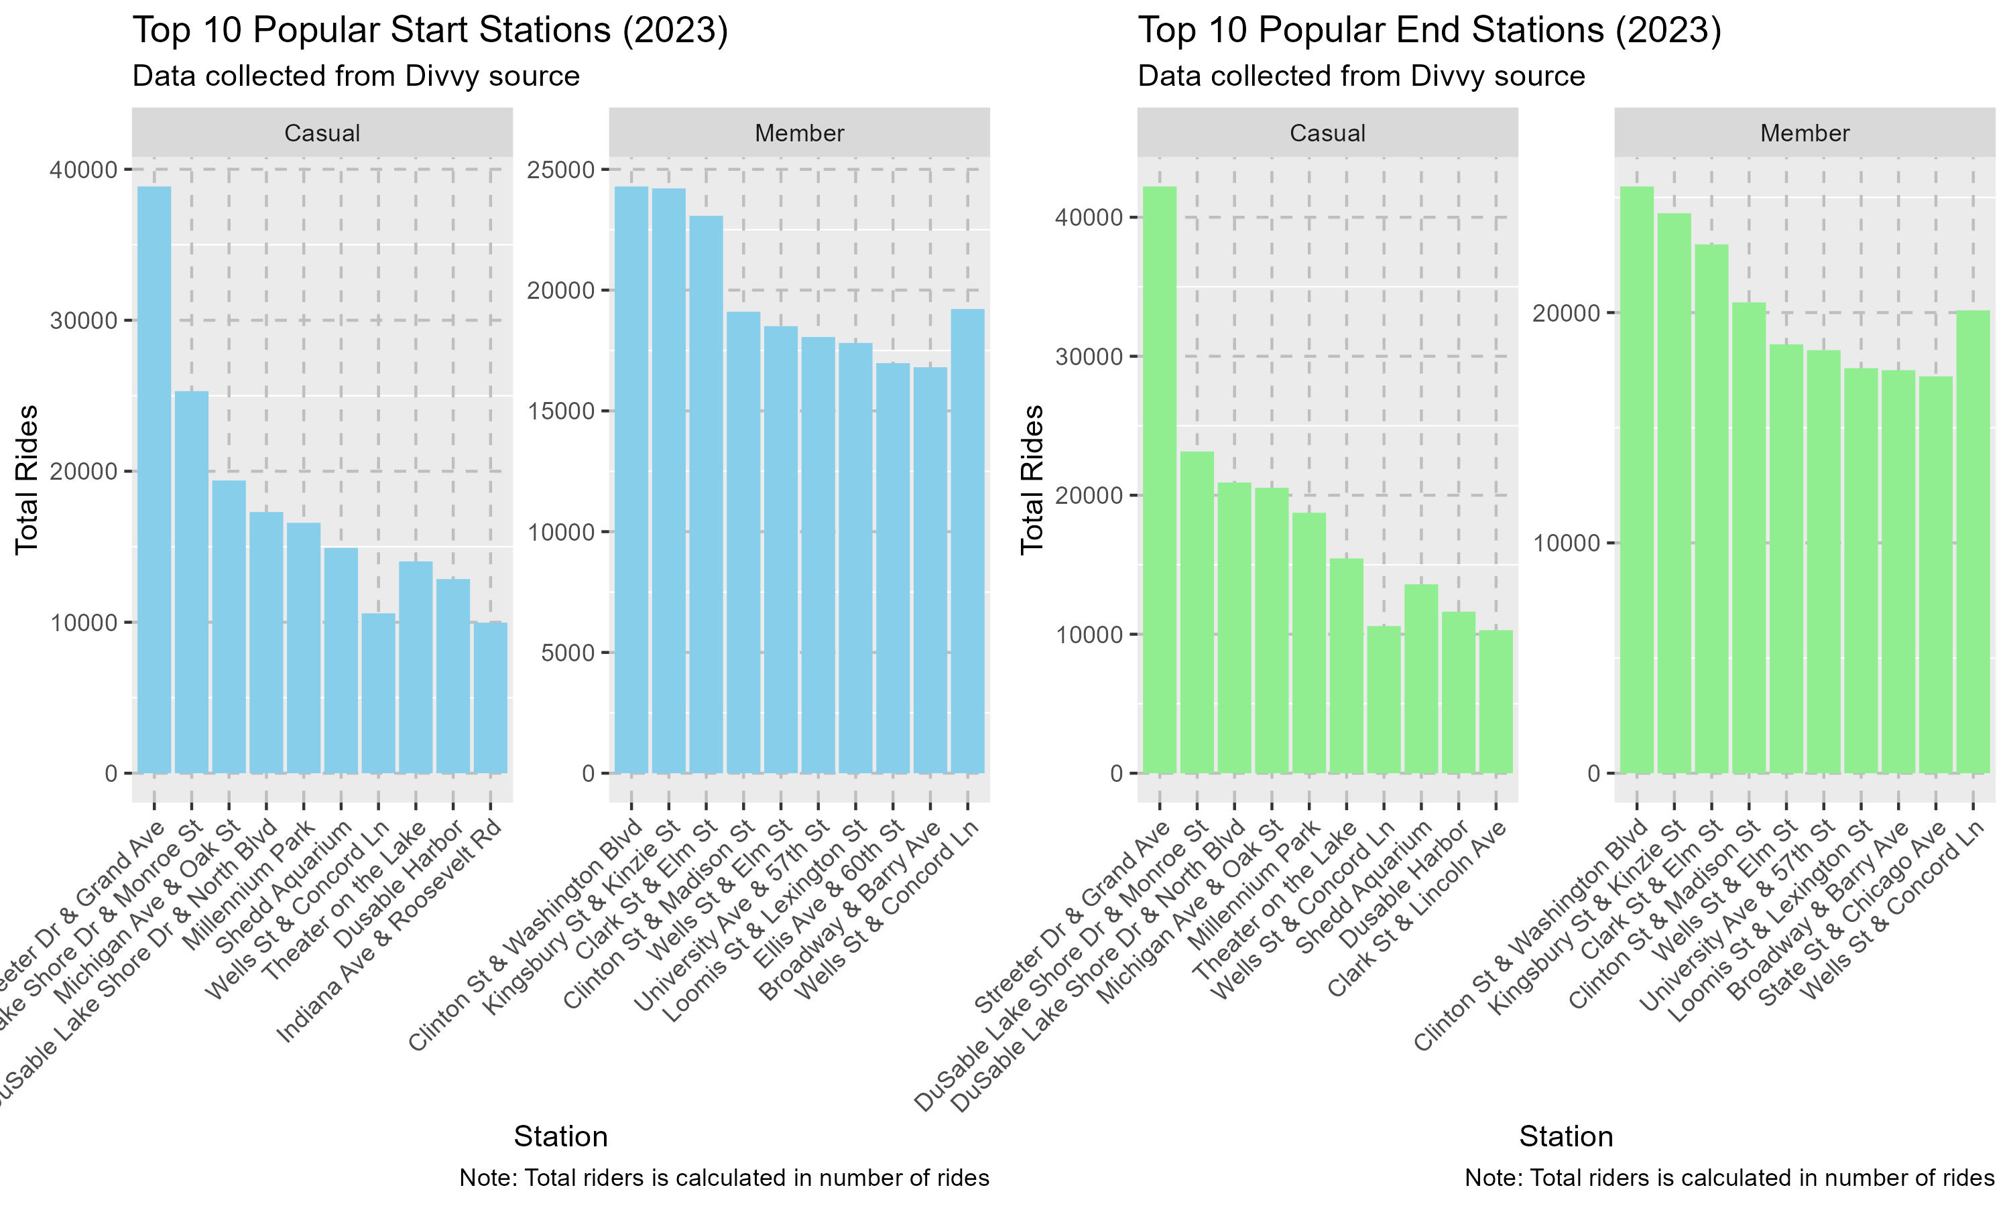
Popular Stations
Bar chart showing the popularity of start and end stations for casual riders and members.
Key Points:
Different usage patterns between casual riders and members.
Streeter Dr & Grand Ave is most popular start station for casual riders.
Clinton St & Washigton Blvd is most popular end station for annual members.
Some stations are popular among both groups.

Slide 7
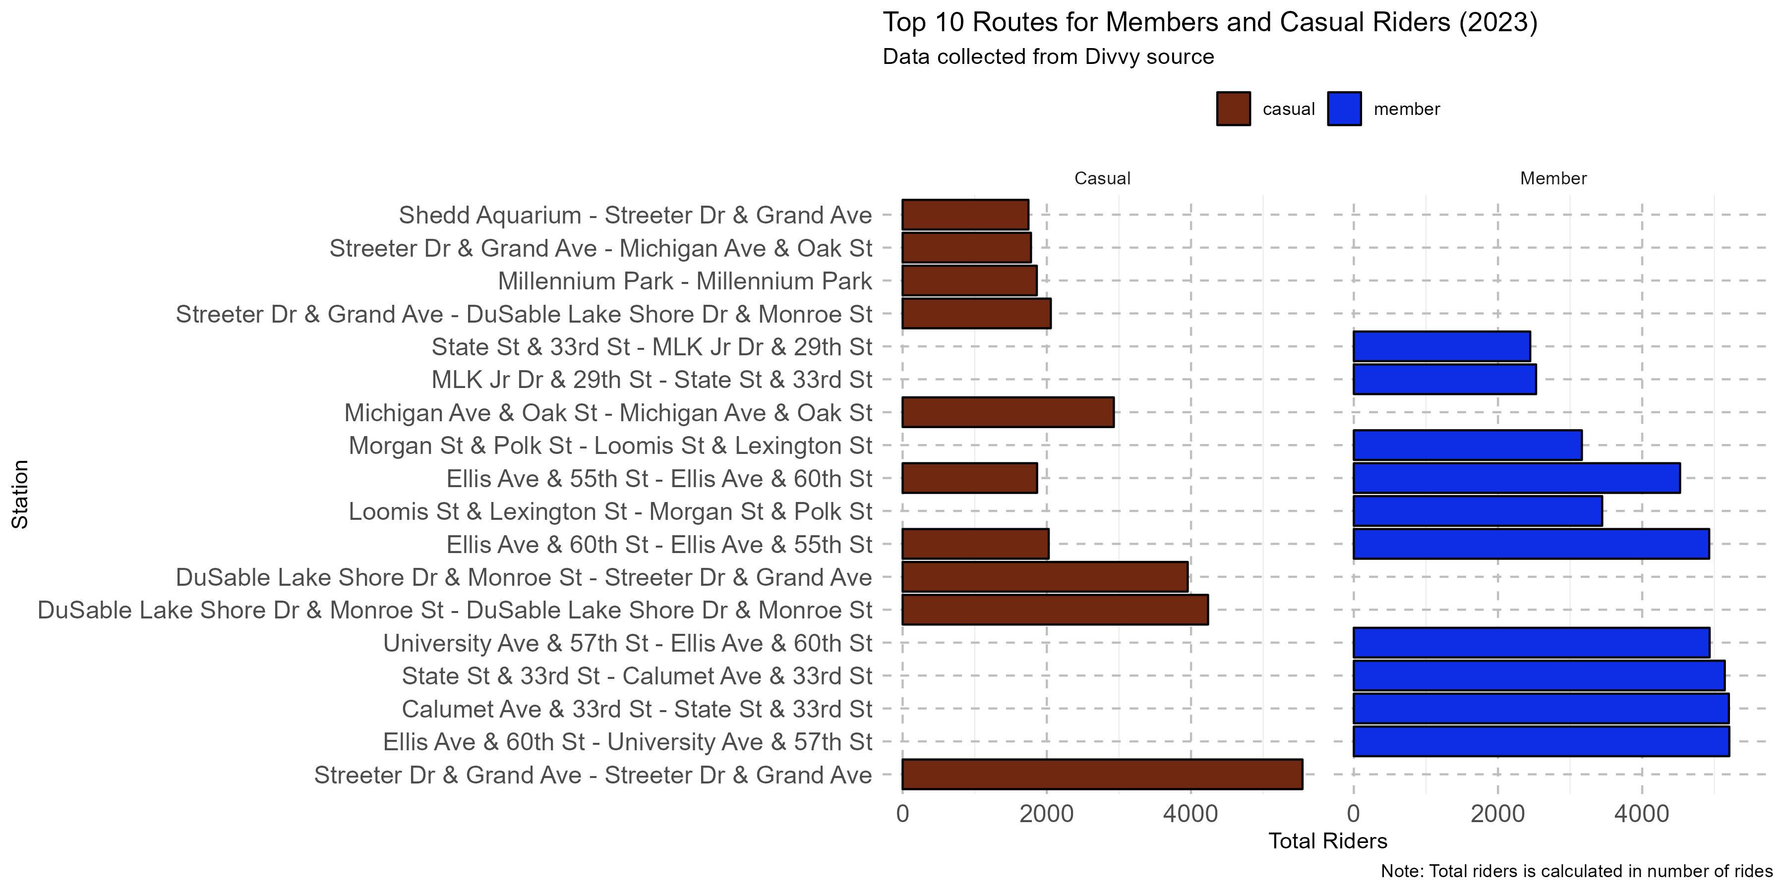
Popular Routes
Bar chart displaying the popularity of routes for casual riders and members.
Key Points:
Varied route preferences between casual riders and members.
Streeter Dr & Grand Ave - Streeter Dr & Grand Ave is most popular routes for casual riders.
Elise Ave & 60th St – University Ave & 57th St is most popular routes for annual members.
Some routes are popular among both groups.

Slide 8
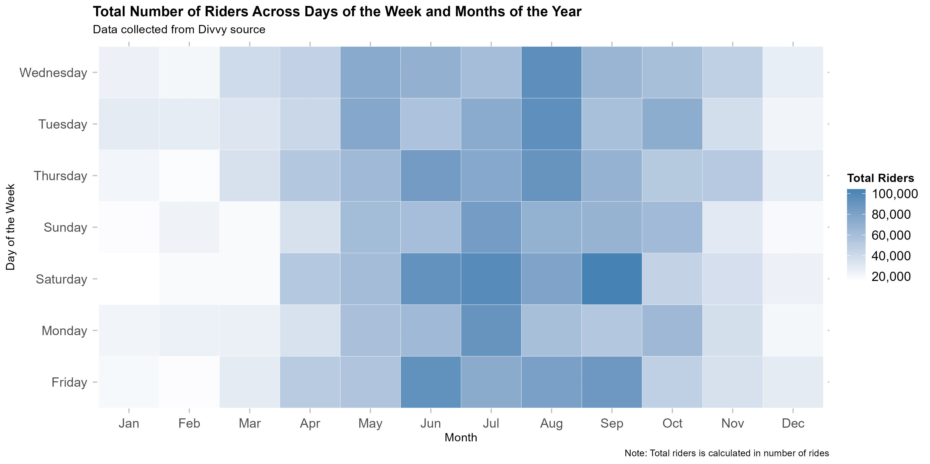
Ridership Patterns
Heatmap showing the total number of riders across days of the week and months of the year.
Key Points:
Peak Ridership: The highest number of riders is observed on Saturdays and in the month of July.
Lowest Ridership: The lowest number of riders is observed on Wednesdays and in the month of February.

Slide 9
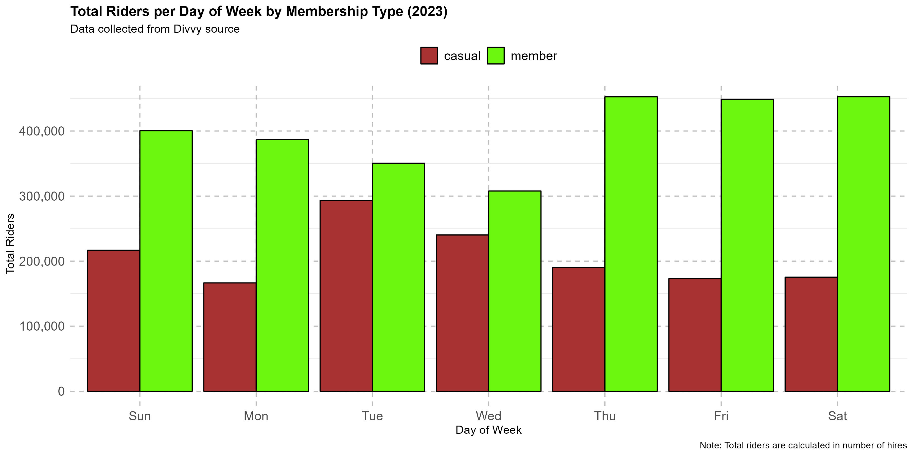
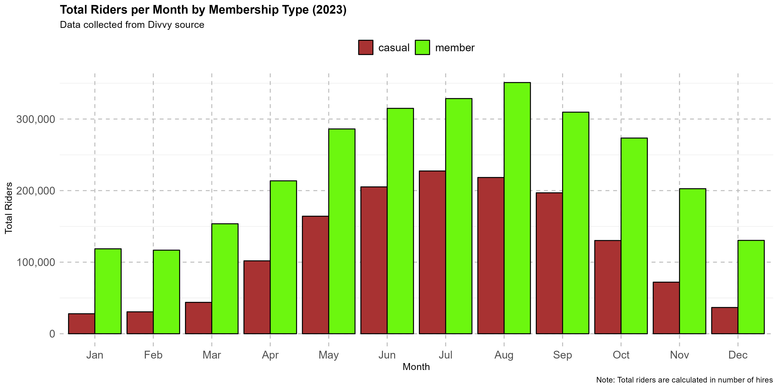
Ridership Patterns by Membership Type
Bar plot visualizing Total riders by day_of_week and month per membership type
Key Points:
Members:
Peak Ridership: The highest number of riders is observed on Sundays and in the month of July.
Lowest Ridership: The lowest number of riders is observed on Mondays and in the month of January.
Casual:
Peak Ridership: The highest number of riders is observed on Sundays and in the month of July.
Lowest Ridership: The lowest number of riders is observed on Tuesdays and in the month of January.

Slide 10
Conclusion
Summary of key findings and insights:
User Demographics: Members comprise the majority (65.8%) of hires, while casual users make up 34.2%. There is a significant potential to convert casual users to members, given the higher retention and revenue potential associated with membership.
Ride Lengths and Usage Patterns: Casual users tend to have longer ride lengths, particularly in July and August, suggesting leisure or tourism usage. There are distinct usage patterns between casual riders and members, indicating different needs and preferences.
Popular Stations and Routes: Streeter Dr & Grand Ave is the most popular start station for casual riders, while Clinton St & Washigton Blvd is the most popular end station for annual members. Some stations and routes are popular among both groups, indicating areas of overlap in usage.
Peak Ridership: Peak ridership occurs on Saturdays and in July, while the lowest ridership is observed on Wednesdays and in February. There are differences in peak and low ridership days between members and casual users.
Potential recommendations:
Targeted Marketing and Promotions: Develop targeted marketing campaigns to incentivize casual users to become members. Offer promotions, discounts, and loyalty programs to encourage conversion. Highlight the benefits of membership, such as cost savings and exclusive features.
Enhanced User Experience: Improve the user experience by optimizing station locations, ensuring availability of bikes and docks, and enhancing infrastructure at popular stations. Provide amenities such as bike repair stations and signage to enhance convenience and safety for riders.
Route Optimization: Analyze route preferences and optimize routes based on user feedback and demand patterns. Consider adding or modifying routes to cater to specific user needs, such as leisure or commuting purposes. Enhance signage and navigation along popular routes to improve the overall cycling experience.
Seasonal Promotions: Offer seasonal promotions and packages targeting tourists and leisure riders during peak months. Collaborate with local attractions or hotels to offer bundled packages that include bike rentals as part of tourist experiences. Highlight scenic or convenient routes to attract new users during peak seasons.

